Slide 1
Tutorial 13
Design an Asynchronous Mod-20 counter using T-Flip Flop.

Slide 2
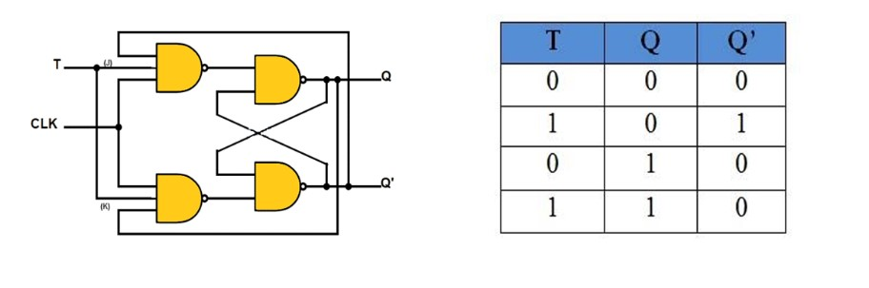
T- Flip Flop

Slide 3
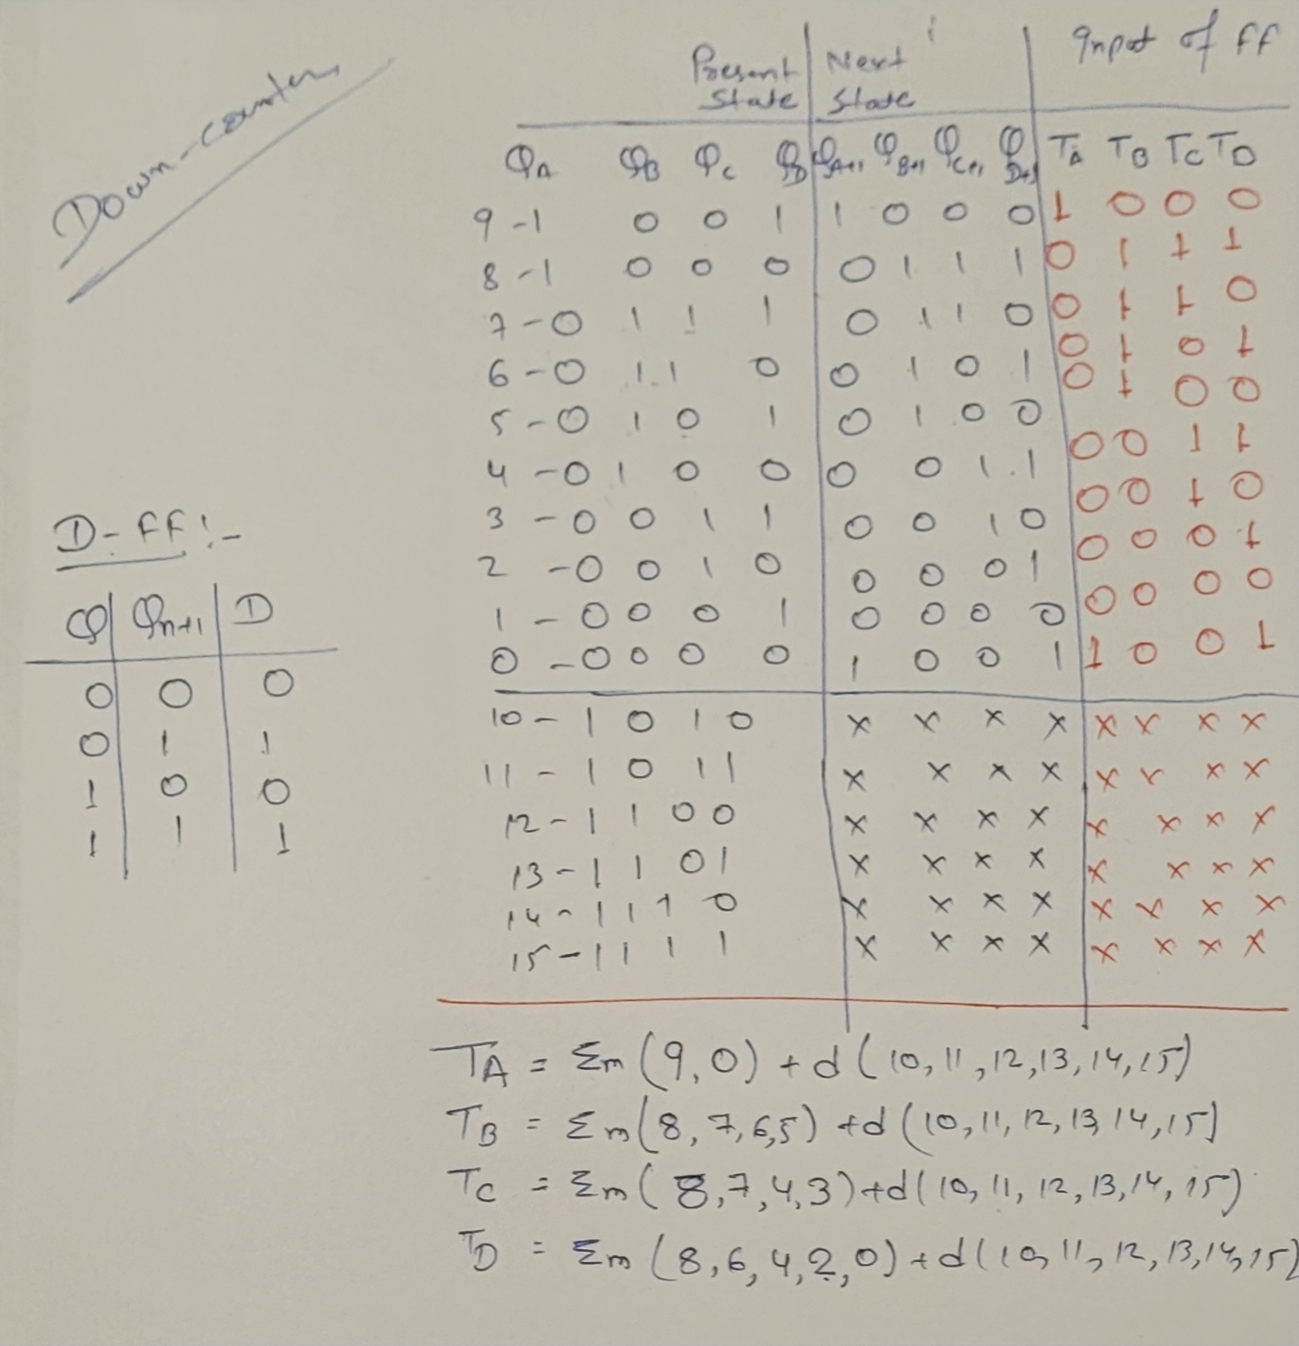
Mod 10 counter using D flip-flop

Slide 4
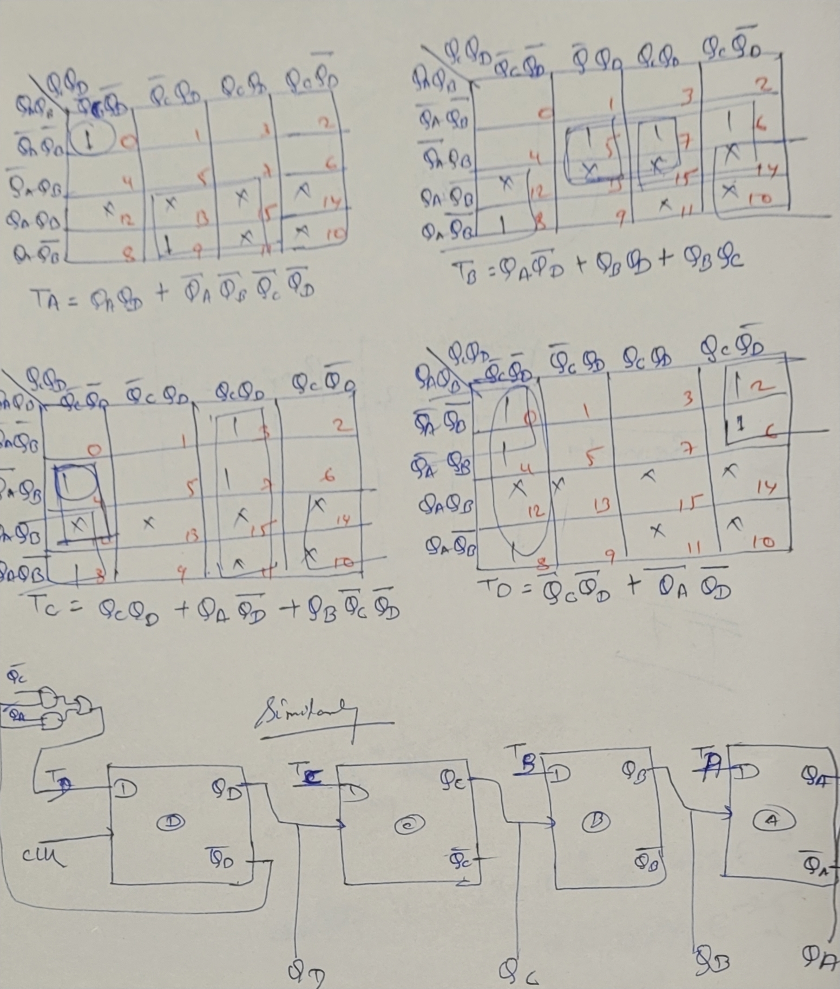

Slide 5
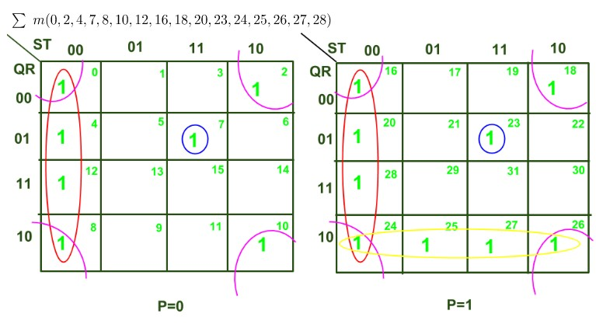

Slide 6
